Slide 1
DOOR LOCK SYSTEM
Embedded System
Course
Ibrahim Ahmad AlAli 2017980008 Ayham Huwari 2017980056

Slide 2
Door Lock System :
What are door locks?
How dose it work?
Device :
Arduino board
Servo motor
Keypad
Lcd
Led
Code
Proteus and Run

Slide 3
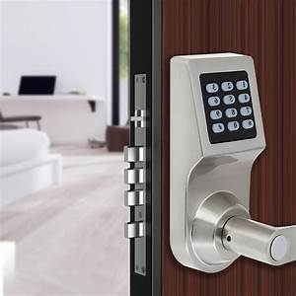
What are door locks?
Nowadays security is the main concern Each and
every individual needs to feel secure.
The main entrances, lockers, cabinets, etc should be
protected with some kind of security systems.
Doors locked using the conventional locks are not as safe as they used to be in the past, nowadays anyone can easily break-in by breaking these locks.
The password-based door lock system allows only authorized persons to access the restricted areas.

Slide 4
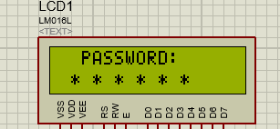
How dose it work?
When you enter the correct 8 digit password the door is opened for 5 seconds, GREEN LED is ON .
Currently, the password is 88776655, which you can change in the programming ,you can even select a password consisting of more than 8 digits.
If a wrong password is entered 3 times the system is locked out for 10 seconds and an RED LED is turned ON, we also can increase or decreased The number of wrong attempts as per the requirement.

Slide 5
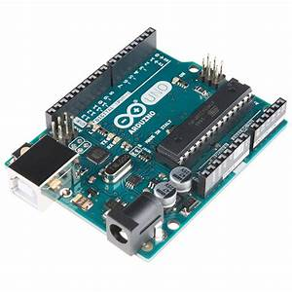
Arduino board:
The entire project is controlled using
the Arduino.
There is many types of arduino boards such that uno, nano, mega, bt… , We used in this project arduino uno.
Its an open source programmable circuit board that can be integrated into a wide variety of makerspace projects both simple and complex.
This board contains a microcontroller which is able to be programmed to do a spacific function.
it’s flexible and low cost.

Slide 6
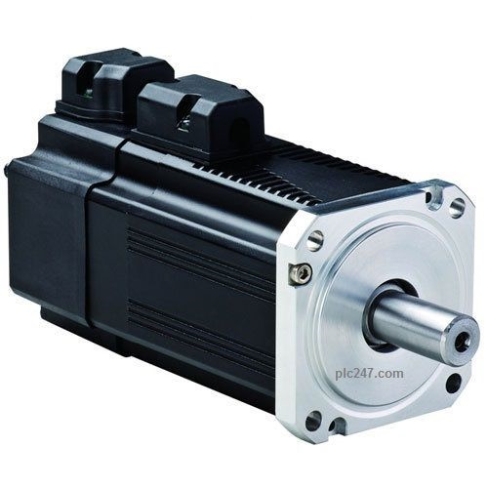
Servo motor:
A servo motor, is a device that is used to rotate or push parts of a machine to which it is connected with precision.
Unlike DC motors, they generally rotate to a particular angle and then stop .

Slide 7
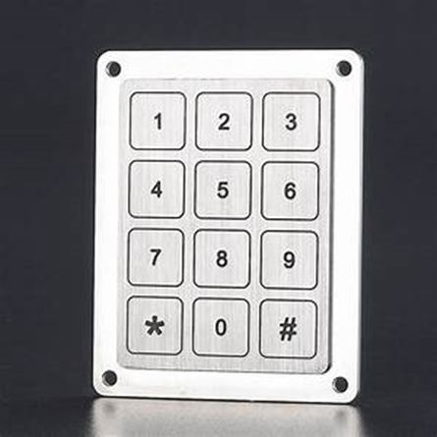
Keypad:
A keypad is one of the most commonly used input devices in microprocessor applications.
A great way to let users interact with their project to navigate menus, enter passwords, control robots, and the like
The working principle is very simple. Pressing a button shortens one of the row lines and one of the column lines, allowing current to flow between them

Slide 8
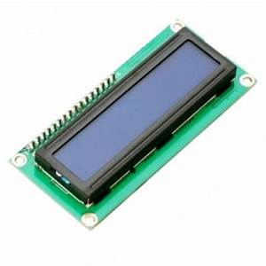
Lcd:
it can display any text or value of variables.
16X 2 Lcd contans 2 rows and 16 columns , so it can show about 32 character.
Lcd.setCursor(col, row);
lcd.print(”any text”);

Slide 9
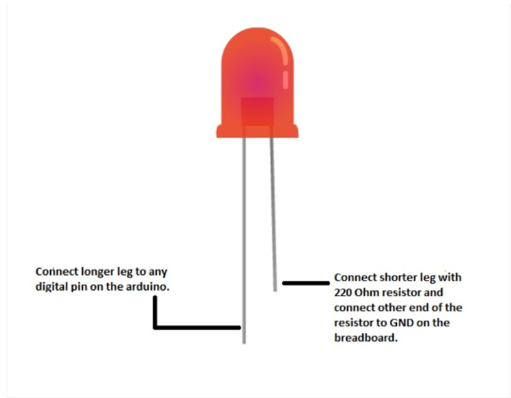
Led :

Slide 10

Code :
Some libraries needed:

Slide 11
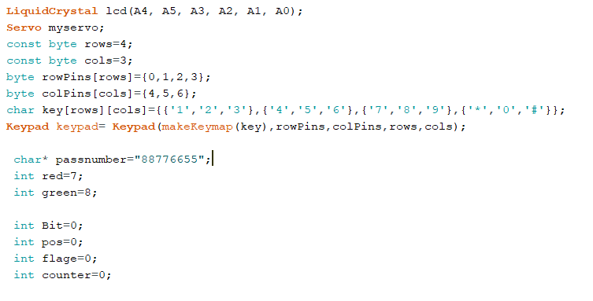

Slide 12
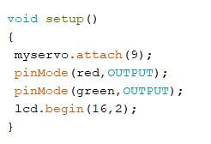
void setup

Slide 13
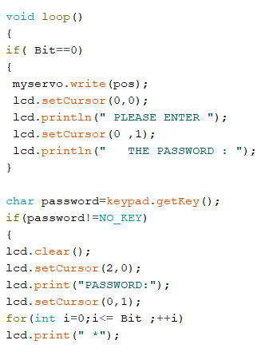
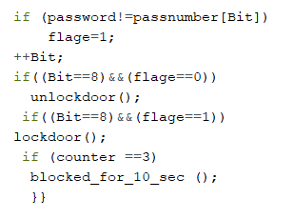

Slide 14
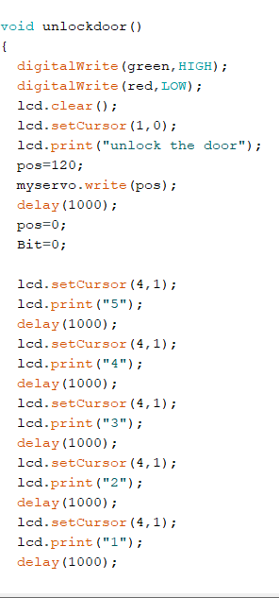
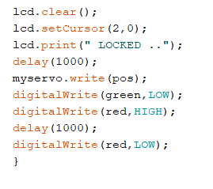

Slide 15
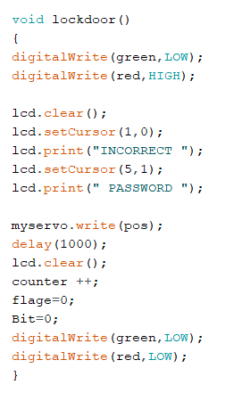

Slide 16
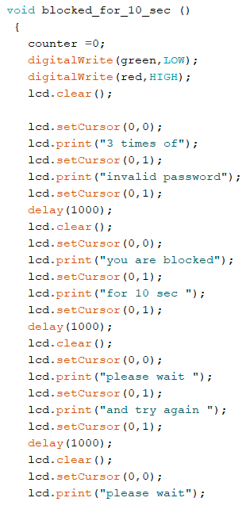
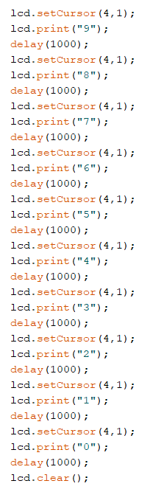


Slide 17
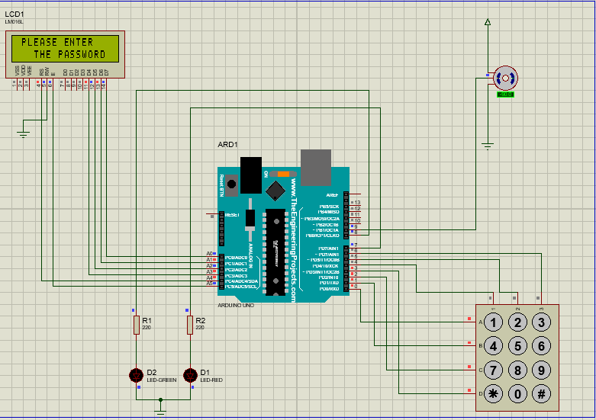
Proteus and run

